Slide 1
ENIAC CASE STUDY
Nadine, Lana, Jonathan, Manisankar

Slide 2
01
IS MAGIST A GOOD FIT FOR HIGH-END TECH PRODUCTS
02
ARE ORDERS DELIVERED ON TIME?
03
MARKET INSIGHTS and CONCLUSION

Slide 3
DATA ANALYSIS CONCLUSION
MAGIST IS NOT A SUITABLE PARTNER IN BRAZIL.
Tech products represent only ~7% of sales, while low customer satisfaction and long delivery times make them strategically unattractive.

Slide 4
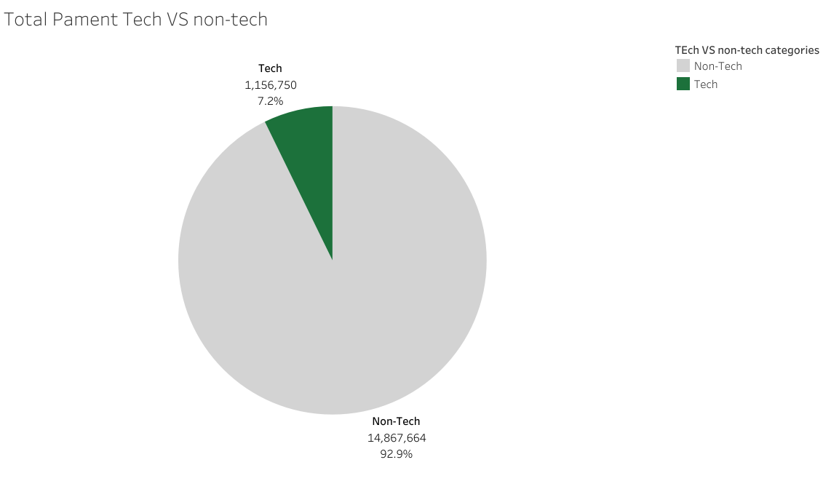
TECH CATEGORIES
At Magist, tech products represent only around 7% of total sales, indicating a relatively limited share within the overall portfolio.
The tech categories are:
electronics
computers_accessories
pc_gamer
computers
tablets_printing_image
telephony
01

Slide 5
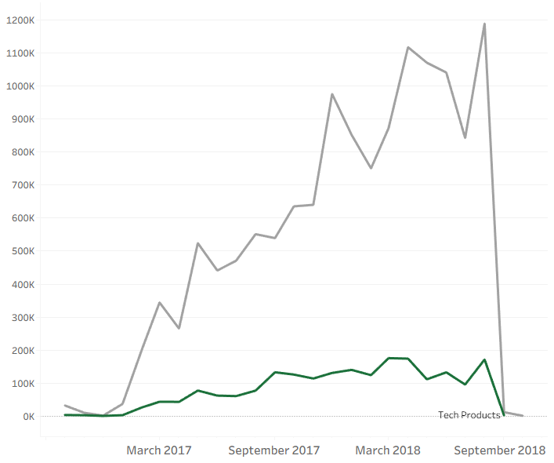
Trend of Sales in tech vs nontech Products
upward trend in nontechsales
steady & low tech sales
01

Slide 6
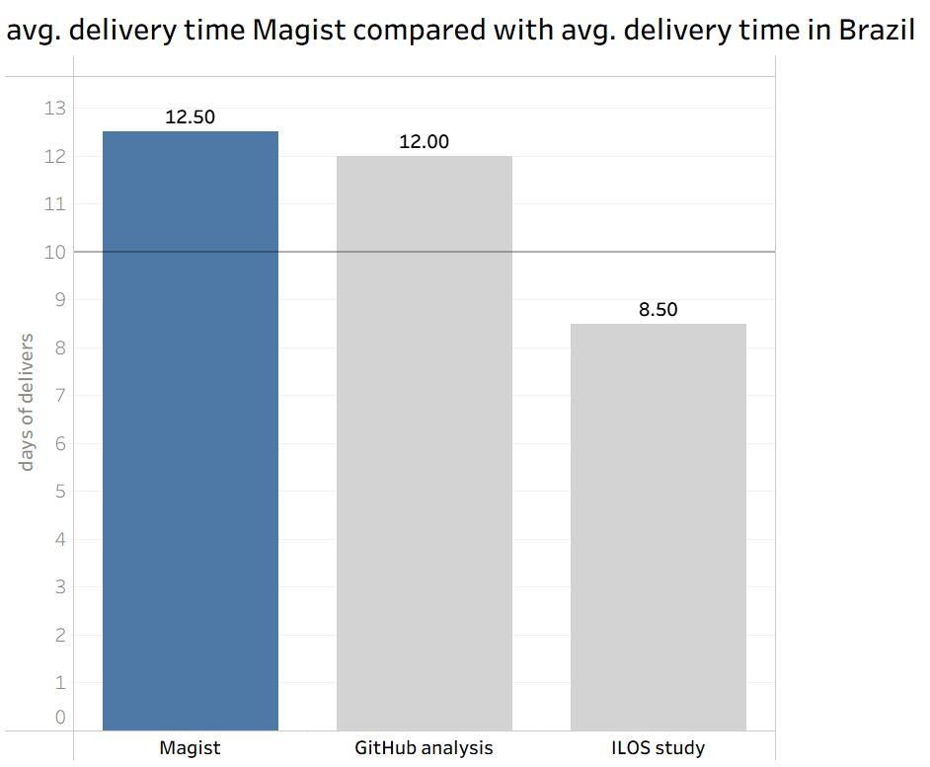
AVG DELIVERY TIME OF MAGIST
THE AVG DELIVERY TIME IN BRAZIL IS ~ 10 DAYS
E-COMMERCE ANALYSES FROM GITHUB & ILOS INSTITUTE
02

Slide 7
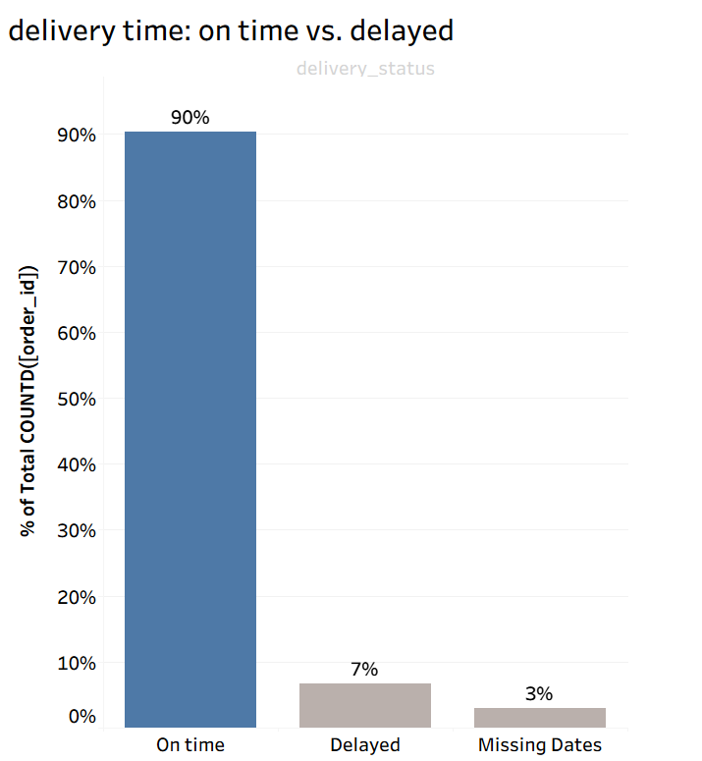
DELIVERY
TIME
ON TIME = DELIVERY BEFORE THE ESTIMATED TIME
10% ARE DELAYED OR MISSING DATES
02

Slide 8
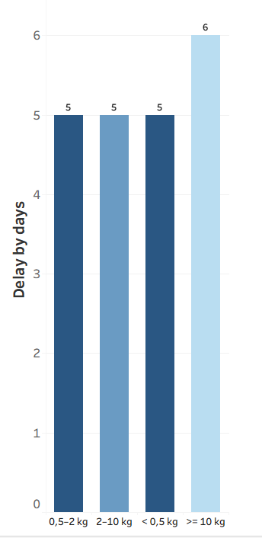
Average delivery delay by days
slighty higher delvery time for very heavy orders
otherwise evenly distributed delay
02

Slide 9
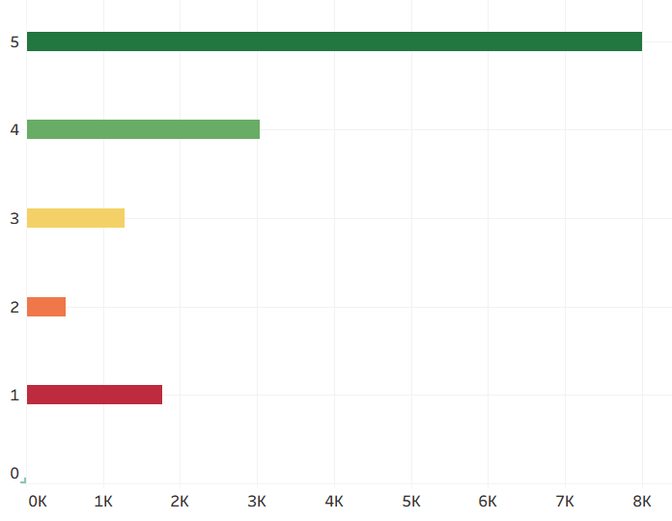
TECH PRODUCT REVIEWS FROM CUSTOMERS
OVERALL GOOD/OK REVIEWS
STILL CONSIDERABLE AMOUNT OF NEGATIV REVIEWS
EVERY 5TH REVIEW IS NEGATIVE IF WE CONSIDER 4 AND 5 STARS AS POSITIVE
02

Slide 10
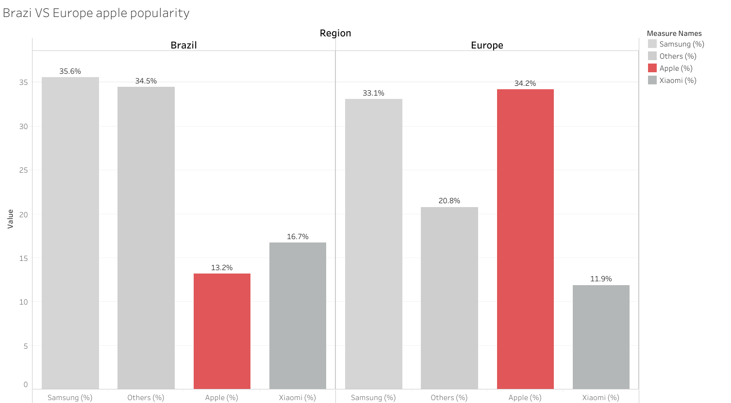
MARKET INSIGHTS
Apple’s market share in Brazil (13%) is significantly lower compared to Europe (34%). This highlights a clear gap in iOS adoption between the two regions.
03

Slide 11
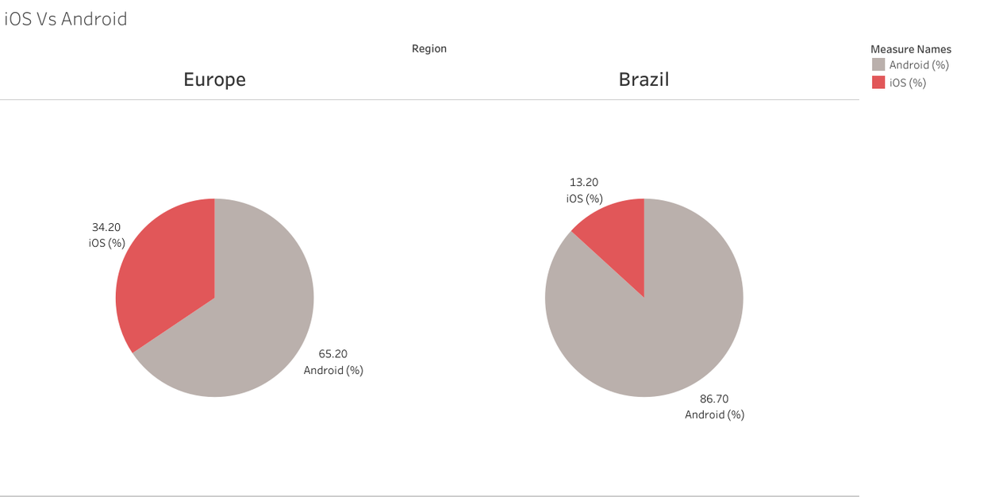
RECOMMENDATION
Brazil is not a favorable market for Apple products.
Focus on other markets first, then seek a partner with stronger tech expertise, faster delivery, and higher customer satisfaction.
03

Slide 12
THANK YOU
Nadine, Lana, Jonathan, Manisankar

